Slide 1


Aspire Overflow | TEAM AURORA
CHENNAI, 25-07-2022
Notes:
Click on the icon to add background picture.
Right click on the photo and use CROP option to adjust its position.
Please only use photos with a clean, bright background so the title, date and Aspire logo stands out.
Samples with photos are in the last section of this template.

Slide 2
Team MEMBERS
Girishkumar R
Gowtham R
Manimaran V
Mohammed Irfan S
Ponvizhi U
Project Duration in Days : 50
Pooja S
Sandhiya S
Sriram M
Venkateshwaran M

Slide 3
EXISTING CHALLENGES
Knowledge sharing will be very limited.
Learnings about the current technologies will not be up-to-date.
Problems and queries takes more time to resolve.

Slide 4
ABOUT THIS APPLICATION
Aspire Overflow is developed for the users inside our office.
The main purpose of this platform is to post your queries and to express your thought about technologies and others through articles.
Employee of our company will be the end users of this application.
Reviewer is an extra privilege given to the users. Reviewer is the one who reviews the articles written by other users.
Admin is another user who has the permission to verify the registered user and allow the user to access the website, he can also manage the reviewers and spams reports.

Slide 5
SOLUTION and ARCHITECTURE
Writing of articles about the thing you want to share.
Posting the queries that you have problem with solving.
Answering the queries that you have knowledge of .

Slide 6
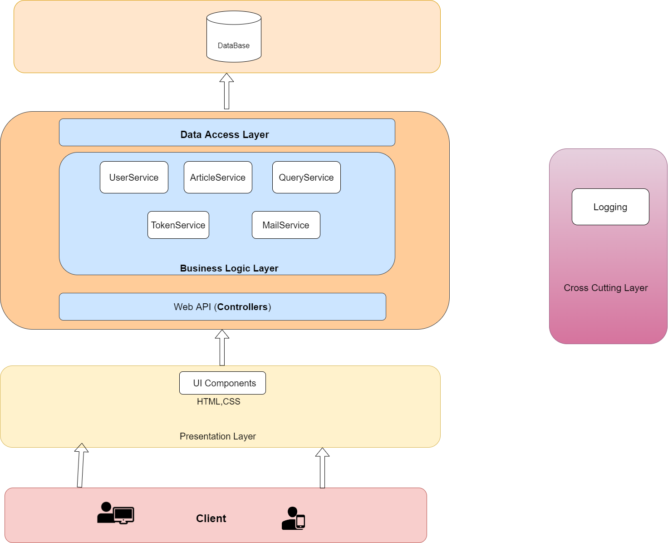
Architecture Diagram

Slide 7
EXECUTION JOURNEY
Kick off and Brain storming
User stories
Functional and Non-Functional Requirements
Wireframe
Data Model
High Level Design
Low Level Design
HTML Template
Estimation Calculation
Angular Components
Web Api
Integration of API and Components
Unit Testing
Set-up Documentation
Code Review and Code Cleanup
SonarQube
Linting
Light House
Deployment in IIS
JMeter
Test Scenarios
Gorrila Testing
ZAP

Slide 8
Artifacts
Areas | Link
Requirement – User Stories, Wireframes, Data Flow | Wireframe and User Stories
Swagger - API | Api-Swagger
Data Model – EAR (Entity Attribute Relationship) | Data Model
Test Scenarios | Test Secarios
Sequence Diagrams | Sequence Diagarm
Defect Logs | Defect Logs
Code Quality Metrics | Sonar and Lint reports
Setup Manual | Setup Manual

Slide 9
TECHNOLOGIES , Tools & PLUGINS USED
Dotnet Core 6.0
Angular 13
Visual Studio Code
Node Js
SonarQube
SQL Server Management System
JMeter
ZAP
Data Table – jQuery
Ck editor – Js
Chart - Js

Slide 10
DEMO
Web Api - http://172.24.210.43/Aspire-API/swagger
Angular - http://172.24.210.43/AspireOverflow

Slide 11
LESSONS LEARNED
We need to understand the project and end users of the application before developing.
Requirement gathering is the first-most thing to be done.
User-Stories should tell about the flow of the system.
The Final outcome of the project should reflect the wireframe.
Set-up documentation should be written simple.
Code Clean-up needs to be done.
Need to manage the work with the available members of the team.
Take responsibility and ownership of our work.
If there's anything you have doubt, don't hesitate to ask.
Always Ready with the Backup plan.

Slide 12
Thank you :)

